Slide 1






MYSTERY BOX CHALLENGE
Difficulty Level : Medium
Prof. Dr. Ali Zarafshani
CSCE 5552– CyberSecurity Essentials

Slide 2
Team Members
Grishma Tandu (116162200
Snehasri Doma(11605246)
Pravallika Pandaraboina (11604430)
Prakash Palle (11599393)

Slide 3
What is Mystery Box ??
Mystery Box challenge is to allow an attacker to sign a specific message but without allowing them to sign the message directly. Instead, we have to find a way to uncover RSA signatures as a whole and obtain the valid signature of the target message.
In cryptographic terms, RSA signatures involve using a private key to sign a message, and the corresponding public key can be used to verify the signature. However, in this challenge, there's a twist or limitation which prevents direct signing, requiring us to think creatively and potentially exploit weaknesses in the system to achieve the desired outcome.

Slide 4
Tools Used
Netcat
Kali Linux

Slide 5

Project Components
The key components of the box are:
RSA Key Generation
Signing and Verification

Slide 6
Problem Analysis
RSA Signature Algorithm
Constraints and Objectives
Server Interaction
Exploiting RSA Properties
Error Handling and Edge Cases
Security Implications

Slide 7
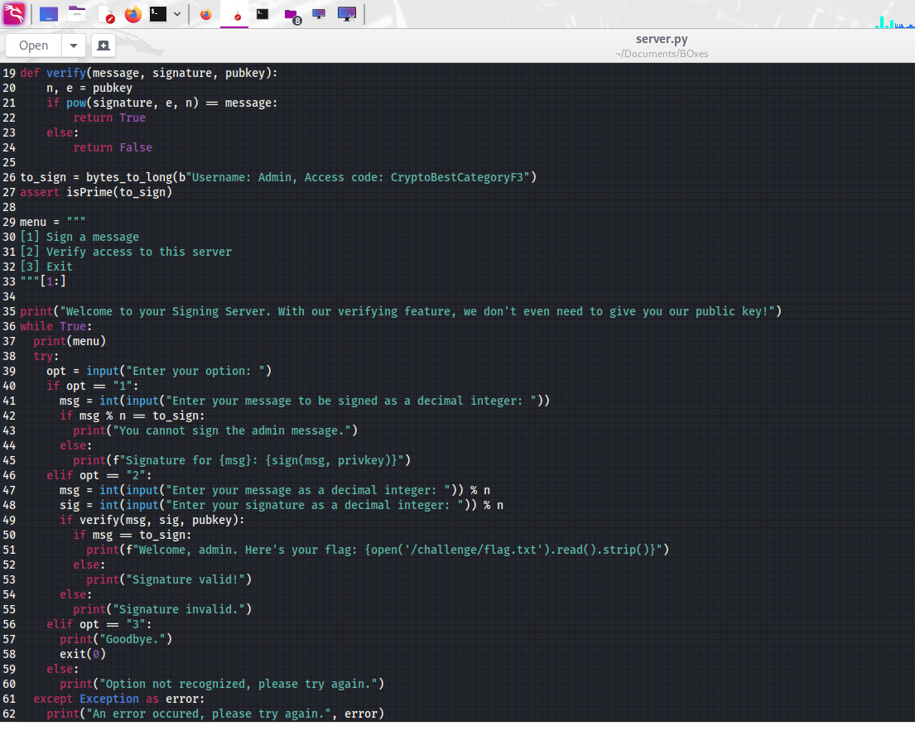
Python Code
Here is the python script code which was provided.

Slide 8
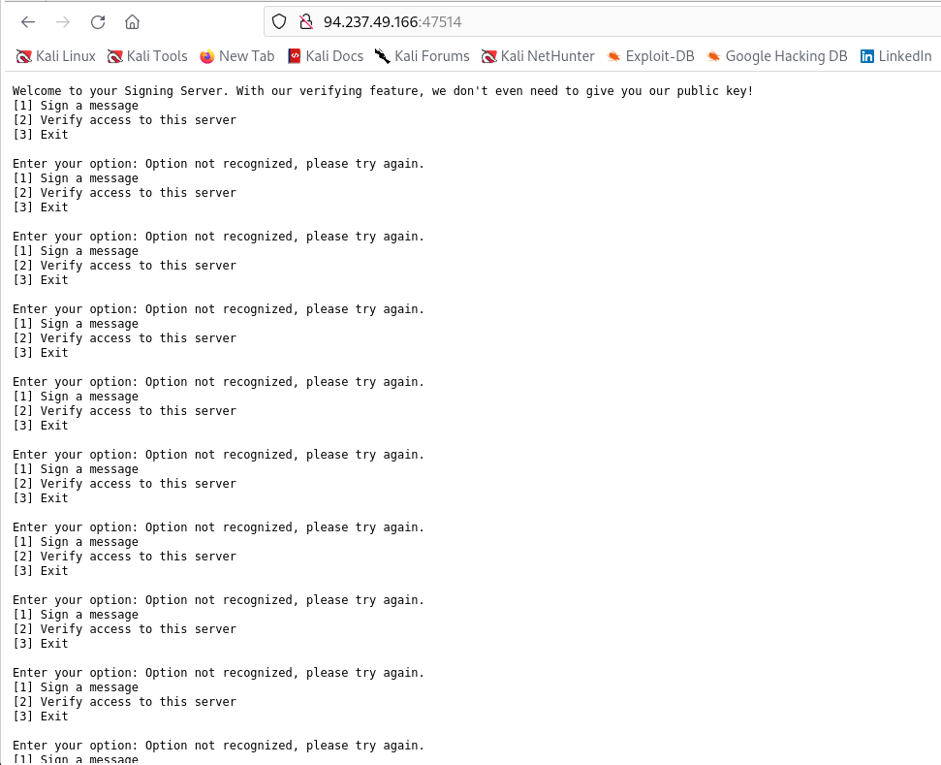
Methodology
Understanding the challenge
As part of understanding we have got this output after accessing the service from web browser.

Slide 9
Methodology (Contd.)
Analyzing the RSA Algorithm
Identifying the Target Message
Exploiting Multiplicative Property
Interacting with the Server
Signing the Negated Message
Verifying the Obtained Signature

Slide 10

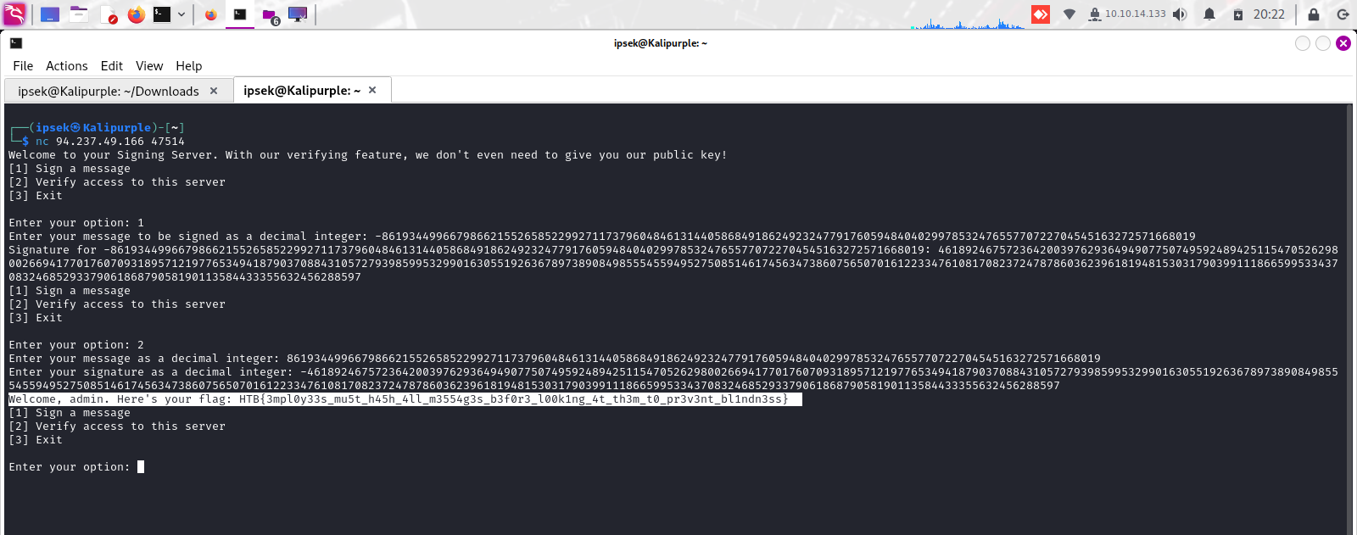



Successful verification of the signature

Slide 11
Lessons Learnt
The cryptographic challenge of the Mystery Box taught five key lessons:
Understanding the RSA Signature Algorithm
Exploiting cryptographic properties
Applying cryptographic principles to real-world scenarios
Demonstrating robust error handling and input validation
Employing an iterative problem-solving approach.
These lessons emphasize the importance of understanding fundamental cryptography algorithms, utilizing creative uses of cryptographic ciphers and algorithms, and applying cryptographic principles to secure communication protocols.

Slide 12
Simulation Video

Slide 13
Conclusion
The RSA signature Mystery box challenge provided valuable learning for cryptography and cybersecurity.
We successfully obtained the target message's signature through problem-solving, strategic thinking, and experimentation.
This challenge highlighted error handling, iterative strategies, and good documentation in cryptography

Slide 14


Slide 15


